Slide 1

CS 188: Artificial Intelligence
Bayes’ Nets: Sampling
Instructors: Adam Janin, Josh Hug --- University of California, Berkeley
[These slides were created by Dan Klein, Pieter Abbeel, Anca Dragan, and Josh Hug. http://ai.berkeley.edu.]
Notes:
Please retain proper attribution, including the reference to ai.berkeley.edu. Thanks!

Slide 2
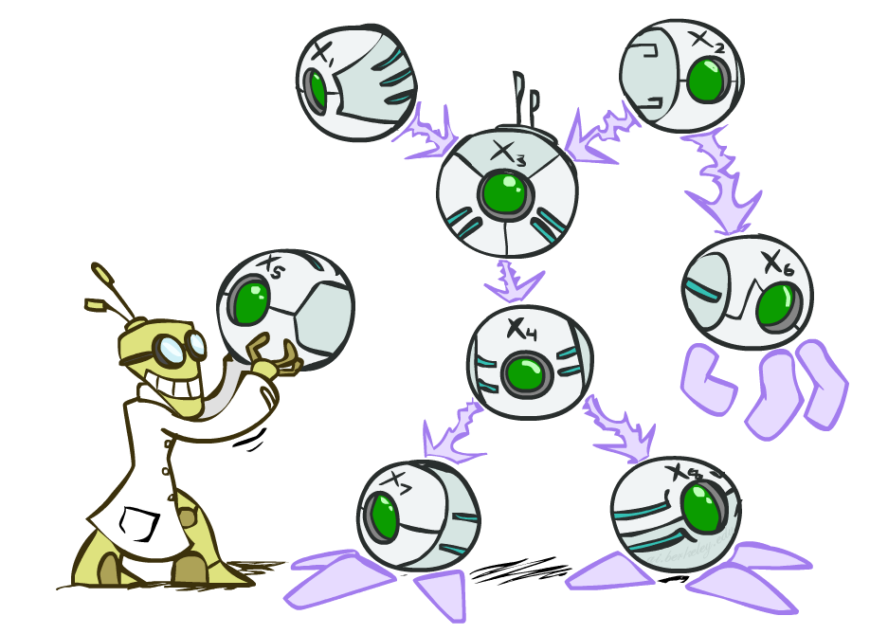
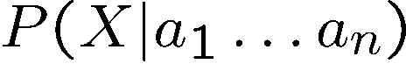
Bayes’ Net Representation
A directed, acyclic graph, one node per random variable
A conditional probability table (CPT) for each node
A collection of distributions over X, one for each combination of parents’ values

Slide 3
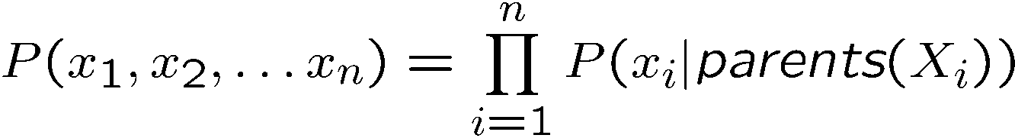
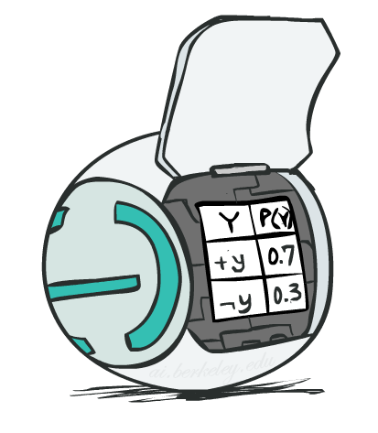
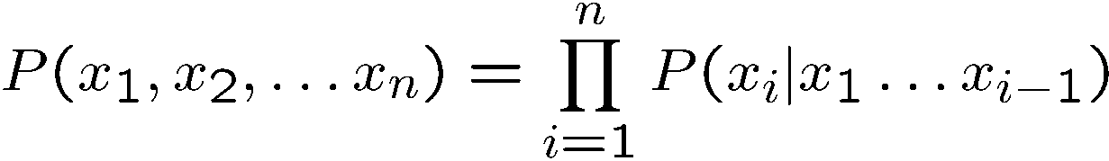
Bayes’ Net Representation
Bayes’ nets implicitly encode joint distributions
As a product of local conditional distributions
To see what probability a BN gives to a full assignment, multiply all the relevant conditionals together:
Less complex than chain rule (valid for all distributions):

Slide 4
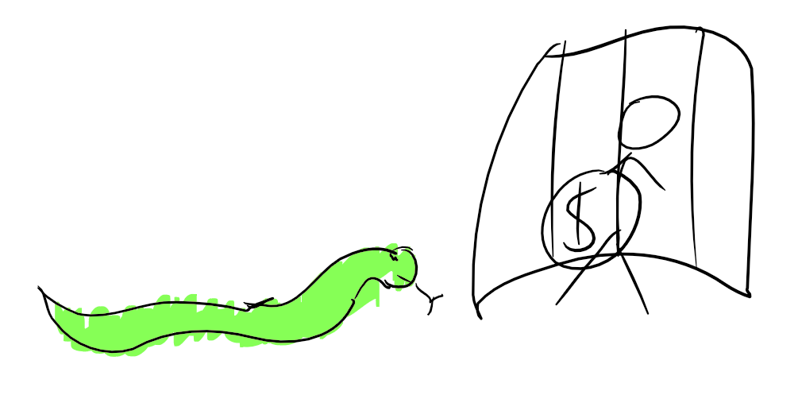
Example Model: Escaping a Dungeon
If we take a treasure:
Cage trap may fall on us.
Snakes may be released.
These two events are determined independently.
Our chance of escaping depends on presence of snakes and cages.
T
C
S
E
Notes:
demo

Slide 5
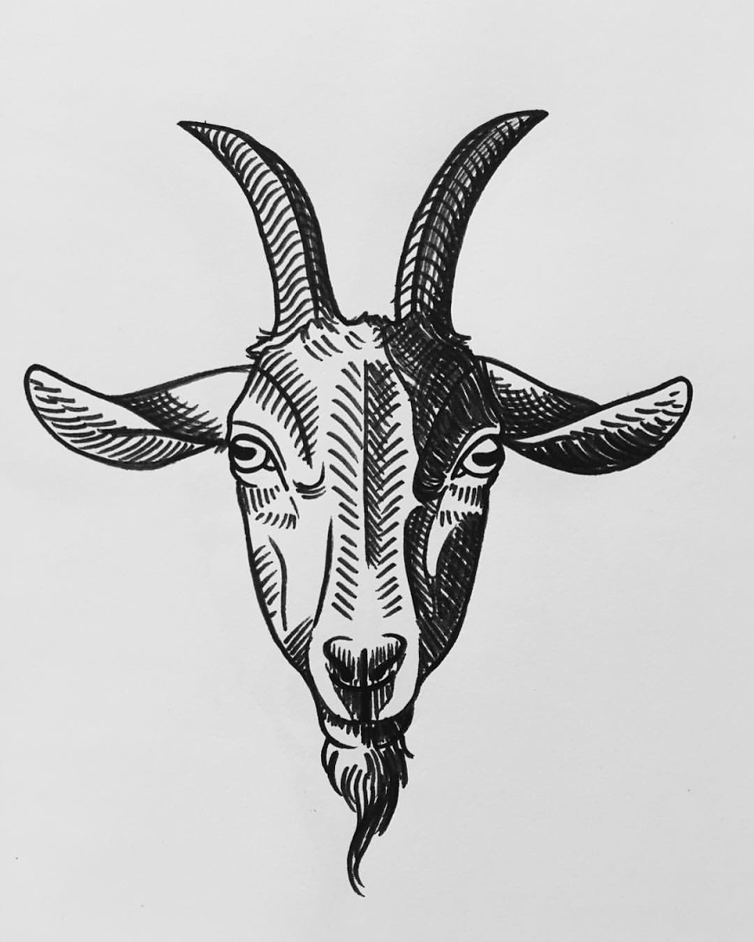
Example Model: Escaping a Dungeon
If we take a treasure:
Cage trap may fall on us.
Snakes may be released.
These two events are determined independently.
Our chance of escaping depends on presence of snakes and cages.
Question: What four factors does our Bayes Net model provide?
Bonus question: How many rows do they have?
T
C
S
E
Notes:
demo

Slide 6
Example Model: Escaping a Dungeon
If we take a treasure:
Cage trap may fall on us.
Snakes may be released.
These two events are determined independently.
Our chance of escaping depends on presence of snakes and cages.
Question: What four factors does our Bayes Net model provide?
P(T): Probability we Take treasure.
P(C | T): Probability of Cage falling on us given whether we take.
P(S | T): Probability of Snake release given whether we take.
P(E | C, S): Probability of Escaping given status of cage and snakes.
T
C
S
E
Notes:
demo

Slide 7
Example Model: Escaping a Dungeon
T | P(T)
+t | 0.75
-t | 0.25
T
T | C | P(C|T)
+t | +c | 0.95
+t | -c | 0.05
-t | +c | 0.0
-t | -c | 1.0
T | S | P(S|T)
+t | +s | 0.1
+t | -s | 0.9
-t | +s | 0.01
-t | -s | 0.99
C | S | E | P(E|C,S)
+c | +s | +e | 0.1
+c | +s | -e | 0.9
+c | -s | +e | 0.2
+c | -s | -e | 0.8
-c | +s | +e | 0.3
-c | +s | -e | 0.7
-c | -s | +e | 0.8
-c | -s | -e | 0.2
C
S
E
Notes:
demo

Slide 8

Computing the Joint PDF
T | P(T)
+t | 0.75
-t | 0.25
T
T | C | P(C|T)
+t | +c | 0.95
+t | -c | 0.05
-t | +c | 0.0
-t | -c | 1.0
T | S | P(S|T)
+t | +s | 0.1
+t | -s | 0.9
-t | +s | 0.01
-t | -s | 0.99
C | S | E | P(E|C,S)
+c | +s | +e | 0.1
+c | +s | -e | 0.9
+c | -s | +e | 0.2
+c | -s | -e | 0.8
-c | +s | +e | 0.3
-c | +s | -e | 0.7
-c | -s | +e | 0.8
-c | -s | -e | 0.2
C
S
E
$P\left(+t, +c, −s, +e\right)= ??$
Notes:
demo

Slide 9
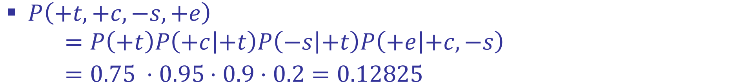
Computing the Joint PDF
T | P(T)
+t | 0.75
-t | 0.25
T
T | C | P(C|T)
+t | +c | 0.95
+t | -c | 0.05
-t | +c | 0.0
-t | -c | 1.0
T | S | P(S|T)
+t | +s | 0.1
+t | -s | 0.9
-t | +s | 0.01
-t | -s | 0.99
C | S | E | P(E|C,S)
+c | +s | +e | 0.1
+c | +s | -e | 0.9
+c | -s | +e | 0.2
+c | -s | -e | 0.8
-c | +s | +e | 0.3
-c | +s | -e | 0.7
-c | -s | +e | 0.8
-c | -s | -e | 0.2
C
S
E
$P\left(+t, +c, −s, +e\right)$
$=P\left(+t\right)P\left(+c | +t\right)P\left(−s | +t\right)P\left(+e | +c, −s\right)$
$=0.75 ⋅0.95⋅0.9⋅0.2=0.12825$
Notes:
demo

Slide 10
The Joint PDF
T | C | S | E | P(T, C, S, E)
+t | +c | +s | +e | 0.007125
+t | +c | +s | -e | 0.064125
+t | +c | -s | +e | 0.12825
+t | +c | -s | -e | 0.513
+t | -c | +s | +e | 0.001125
+t | -c | +s | -e | 0.002625
+t | -c | -s | +e | 0.0027
+t | -c | -s | -e | 0.00675
T | C | S | E | P(T, C, S, E)
-t | +c | +s | +e | 0.0
-t | +c | +s | -e | 0.0
-t | +c | -s | +e | 0.0
-t | +c | -s | -e | 0.0
-t | -c | +s | +e | 0.00075
-t | -c | +s | -e | 0.00175
-t | -c | -s | +e | 0.198
-t | -c | -s | -e | 0.0495
T
C
S
E
P(T, C, S, E): 16 row PDF
$P\left(+t, +c, −s, +e\right)$
$=P\left(+t\right)P\left(+c | +t\right)P\left(−s | +t\right)P\left(+e | +c, −s\right)$
$=0.75 ⋅0.95⋅0.9⋅0.2=0.12825$
Notes:
demo

Slide 11
Inference by Enumeration
T | C | S | E | P(T, C, S, E)
+t | +c | +s | +e | 0.007125
+t | +c | +s | -e | 0.064125
+t | +c | -s | +e | 0.12825
+t | +c | -s | -e | 0.513
+t | -c | +s | +e | 0.001125
+t | -c | +s | -e | 0.002625
+t | -c | -s | +e | 0.0027
+t | -c | -s | -e | 0.00675
T | C | S | E | P(T, C, S, E)
-t | +c | +s | +e | 0.0
-t | +c | +s | -e | 0.0
-t | +c | -s | +e | 0.0
-t | +c | -s | -e | 0.0
-t | -c | +s | +e | 0.00075
-t | -c | +s | -e | 0.00175
-t | -c | -s | +e | 0.198
-t | -c | -s | -e | 0.0495
T
C
S
E
P(T, C, S, E): 16 row PDF
Suppose we want to calculate P(T | +e)?
What is this? A number? A table? If a table, how big?
How would we compute it? (If webcast viewing, compute it!)
Notes:
demo

Slide 12
Inference by Enumeration
T | C | S | E | P(T, C, S, E)
+t | +c | +s | +e | 0.007125
+t | +c | +s | -e | 0.064125
+t | +c | -s | +e | 0.12825
+t | +c | -s | -e | 0.513
+t | -c | +s | +e | 0.001125
+t | -c | +s | -e | 0.002625
+t | -c | -s | +e | 0.027
+t | -c | -s | -e | 0.00675
T | C | S | E | P(T, C, S, E)
-t | +c | +s | +e | 0.0
-t | +c | +s | -e | 0.0
-t | +c | -s | +e | 0.0
-t | +c | -s | -e | 0.0
-t | -c | +s | +e | 0.00075
-t | -c | +s | -e | 0.00175
-t | -c | -s | +e | 0.198
-t | -c | -s | -e | 0.0495
T
C
S
E
P(T, C, S, E): 16 row PDF
Suppose we want to calculate P(T | +e)?
Notes:
demo

Slide 13
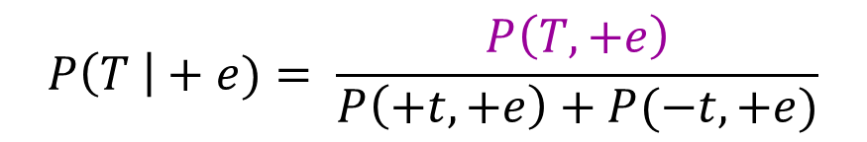
Inference by Enumeration
T | C | S | E | P(T, C, S, E)
+t | +c | +s | +e | 0.007125
+t | +c | +s | -e | 0.064125
+t | +c | -s | +e | 0.12825
+t | +c | -s | -e | 0.513
+t | -c | +s | +e | 0.001125
+t | -c | +s | -e | 0.002625
+t | -c | -s | +e | 0.027
+t | -c | -s | -e | 0.00675
T | C | S | E | P(T, C, S, E)
-t | +c | +s | +e | 0.0
-t | +c | +s | -e | 0.0
-t | +c | -s | +e | 0.0
-t | +c | -s | -e | 0.0
-t | -c | +s | +e | 0.00075
-t | -c | +s | -e | 0.00175
-t | -c | -s | +e | 0.198
-t | -c | -s | -e | 0.0495
P(T, C, S, E): 16 row PDF
$$P\left(T \right|+e)= \frac{P\left(T, +e\right)}{P\left(+t, +e\right)+P(−t, +e)}$$
$$P\left(+t | +e\right)=\frac{0.007125 + 0.12825 + 0.001125 + 0.027}{0.007125 + 0.12825 + 0.001125 + 0.027 + 0.00075 + 0.198}$$
Suppose we want to calculate P(T | +e)?
Keep only the rows consistent with the “evidence”: +e.
Sum out hidden variables S and C, then normalize.
T | P(T| +e)
+t | 0.45135
-t | 0.54865
Notes:
demo

Slide 14
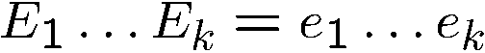
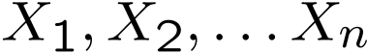
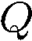
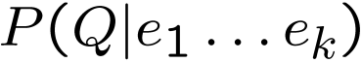
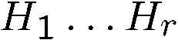
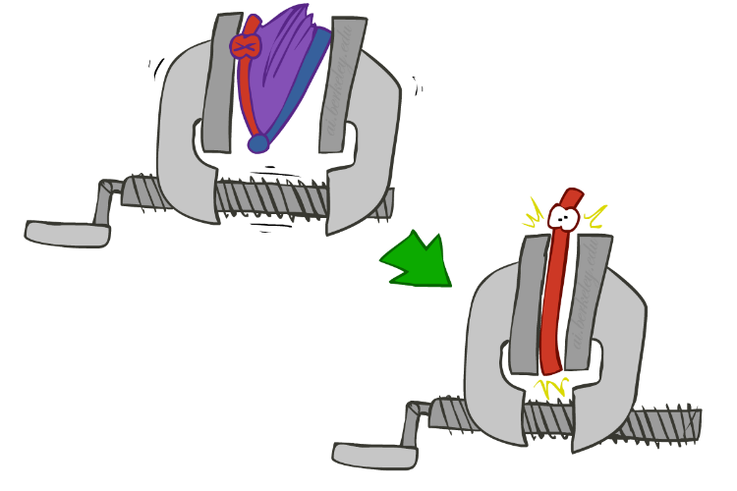
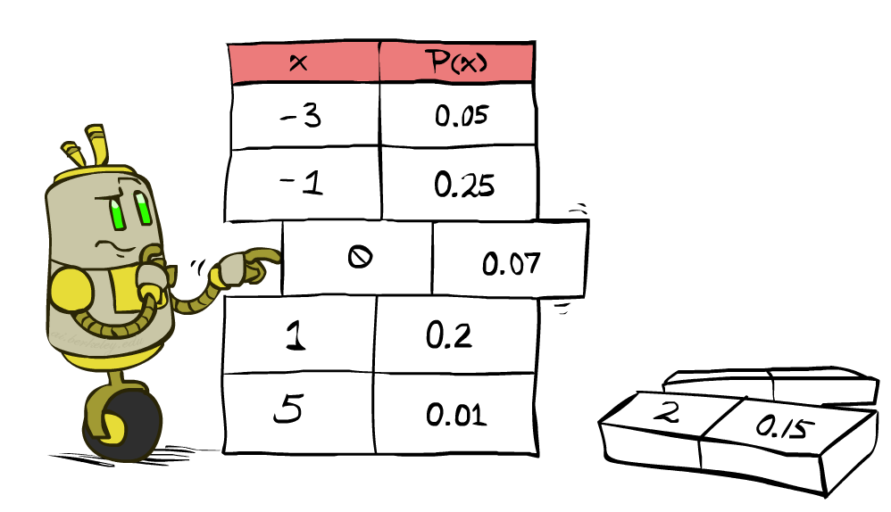
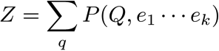
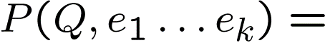
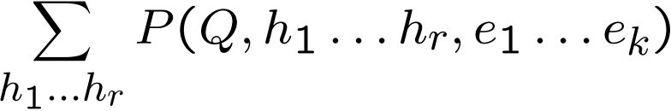
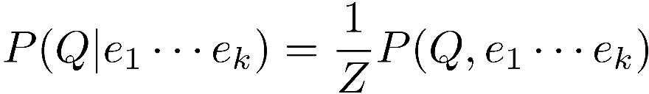
Inference by Enumeration (what we just did)
* Works fine with multiple query variables, too
General case:
Evidence variables:
Query* variable:
Hidden variables:
We want:
All variables
Step 1: Select the entries consistent with the evidence
Step 2: Sum out H to get joint of Query and evidence
Step 3: Normalize

Slide 15
Inference by Enumeration and the Joint PDF
The joint PDF lets us answer any probabilistic inference question trivially using “inference by enumeration” or IBE.
IBE is dumb, but powerful.
IBE is computationally too expensive for practical use (exponentially large joint PDF).
Variable Elimination is an alternate approach (from last time).
Avoids needs to compute joint PDF.
“They who control the joint PDF, control the universe.”
Notes:
demo

Slide 16
Inference on the Joint PDF
Variable Elimination is an alternate approach (from last time).
Avoids needs to compute joint PDF.
Basic idea: Interleave “joins” with “sums”.
Ideally: Smaller maximum table size.
In the worst case, no savings.
Notes:
demo

Slide 17

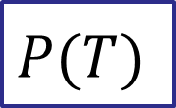
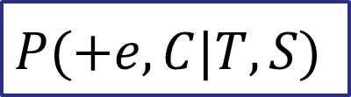
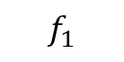
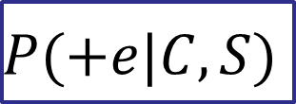
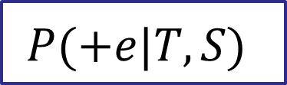
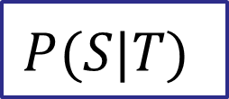
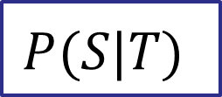
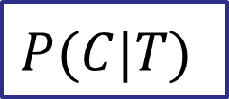

Computing P(T | +e) using Variable Elimination
T
$$P(T)$$
$$P(S|T)$$
$$P(C|T)$$
$$P(+e|C, S)$$
multiply
C
S
$$P(+e,C|T, S)$$
Eliminate C (two step process)
sum over c
+e
$$P(+e|T, S)$$
$$f_{1}$$
$$P(T)$$
$$P(S|T)$$
$$P(+e|T, S)$$
Notes:
demo

Slide 18


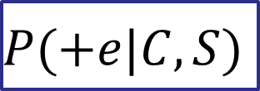
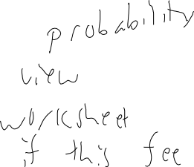
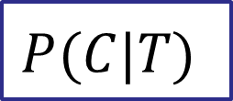
Computing P(T | +e) using Variable Elimination
T | C | P(C|T)
+t | +c | 0.95
+t | -c | 0.05
-t | +c | 0.0
-t | -c | 1.0
T
$$P(C|T)$$
$$P(+e|C, S)$$
multiply
C
S
$$P(+e,C|T, S)$$
C | S | E | P(E|C,S)
+c | +s | +e | 0.1
+c | +s | -e | 0.9
+c | -s | +e | 0.2
+c | -s | -e | 0.8
-c | +s | +e | 0.3
-c | +s | -e | 0.7
-c | -s | +e | 0.8
-c | -s | -e | 0.2
T | S | C | P(+e, C|T,S)
+t | +s | +c | 0.095
+t | +s | -c | 0.015
+t | -s | +c | 0.19
+t | -s | -c | 0.04
-t | +s | +c | 0.0
-t | +s | -c | 0.3
-t | -s | +c | 0.0
-t | -s | -c | 0.8
+e
P(+e, C|T,S) does not sum to anything in particular.
This is OK, it’s just a “Type 3” factor.
Notes:
demo

Slide 19

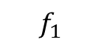
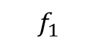

Computing P(T | +e) using Variable Elimination
T
$$P(+e,C|T, S)$$
sum over c
C
S
$$P(+e|T, S)$$
$$f_{1}$$
T | S | C | P(+e, C|T,S)
+t | +s | +c | 0.095
+t | +s | -c | 0.015
+t | -s | +c | 0.19
+t | -s | -c | 0.04
-t | +s | +c | 0.0
-t | +s | -c | 0.3
-t | -s | +c | 0.0
-t | -s | -c | 0.8
+e
T | S | P(+e|T,S)
+t | +s | 0.11
+t | -s | 0.23
-t | +s | 0.3
-t | -s | 0.8
$$f_{1}$$
sum over c
Notes:
demo

Slide 20
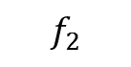


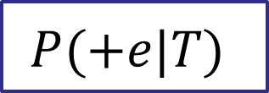

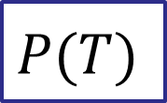
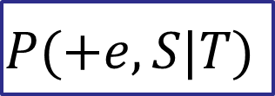
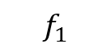

Computing P(T | +e) using Variable Elimination
T
$$P(T)$$
$$P(S|T)$$
$$P(+e|T, S)$$
$$f_{1}$$
multiply
S
$$P(+e,S|T)$$
Eliminate S (two step process)
sum over s
+e
$$P(+e|T)$$
$$f_{2}$$
$$P(T)$$
$$P(+e|T)$$
Notes:
demo

Slide 21
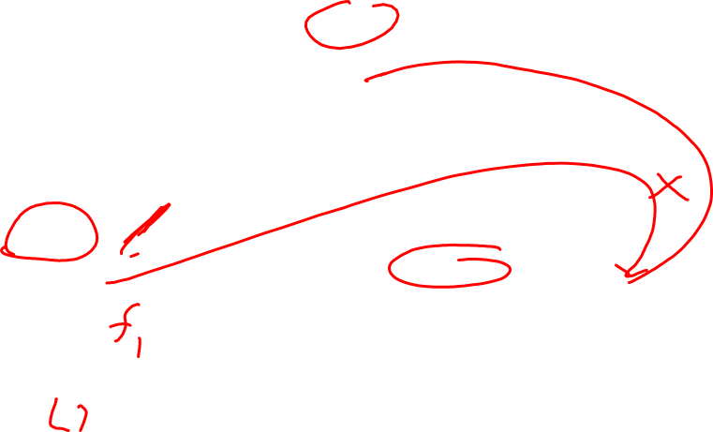
Computing P(T | +e) using Variable Elimination
T
$$P(T)$$
$$P(S|T)$$
$$P(+e|T, S)$$
$$f_{1}$$
multiply
S
$$P(+e,S|T)$$
T | S | P(S|T)
+t | +s | 0.1
+t | -s | 0.9
-t | +s | 0.01
-t | -s | 0.99
+e
T | S | P(+e, S|T)
+t | +s | 0.011
+t | -s | 0.207
-t | +s | 0.003
-t | -s | 0.792
T | S | P(+e|T,S)
+t | +s | 0.11
+t | -s | 0.23
-t | +s | 0.3
-t | -s | 0.8
Notes:
demo

Slide 22
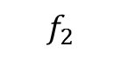
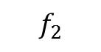

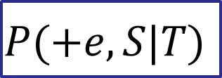
Computing P(T | +e) using Variable Elimination
T
$$P(T)$$
$$P(+e,S|T)$$
sum over s
S
T | S | P(S|T)
+t | +s | 0.1
+t | -s | 0.9
-t | +s | 0.01
-t | -s | 0.99
$$P(+e|T)$$
$$f_{2}$$
+e
T | S | P(+e, S|T)
+t | +s | 0.011
+t | -s | 0.207
-t | +s | 0.003
-t | -s | 0.792
$$f_{2}$$
T | S | P(+e|T,S)
+t | +s | 0.11
+t | -s | 0.23
-t | +s | 0.3
-t | -s | 0.8
T | E | P(+e|T)
+t | +e | 0.218
-t | +e | 0.795
sum over s
Notes:
demo

Slide 23

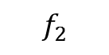
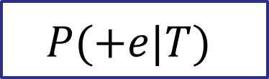
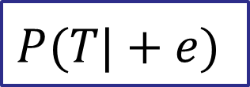
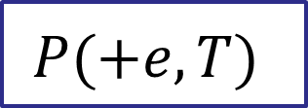
Computing P(T | +e) using Variable Elimination
T
$$P(T)$$
$$P(+e|T)$$
$$f_{2}$$
multiply
$$P(+e,T)$$
normalize
+e
$$P(T|+e)$$
Notes:
demo

Slide 24
Computing P(T | +e) using Variable Elimination
T
T | P(T)
+t | 0.75
-t | 0.25
$$P(T)$$
$$P(+e|T)$$
$$f_{2}$$
multiply
$$P(+e,T)$$
normalize
T | E | P(+e|T)
+t | +e | 0.218
-t | +e | 0.795
$$P(T|+e)$$
+e
T | P(+e, T)
+t | 0.1635
-t | 0.19875
T | P(T | +e)
+t | 0.45134
-t | 0.54865
Handy for debugging lectures!
normalize
Notes:
demo

Slide 25
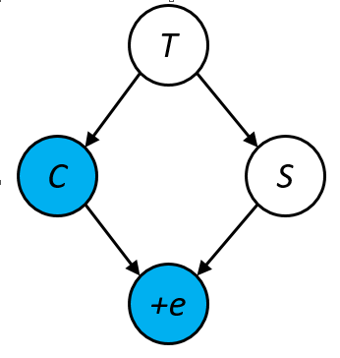
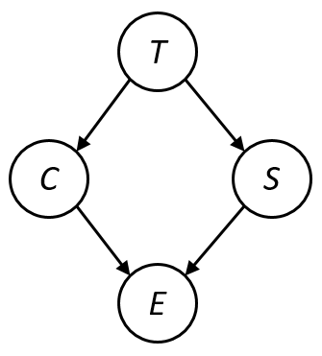
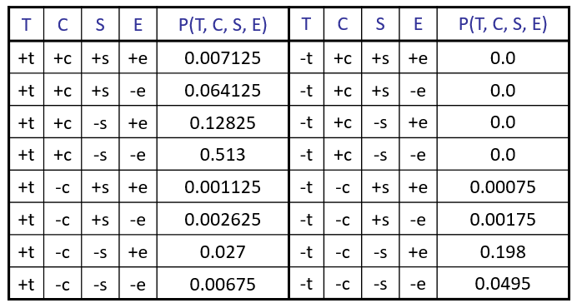
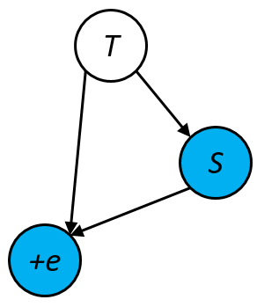



IBE vs. Variable Elimination
calculate
joint pdf
Eliminate C
Select consistent entries
Eliminate S
Sum out hidden variables and normalize
T | P(T | +e)
+t | 0.45134
-t | 0.54865
T | P(T | +e)
+t | 0.45134
-t | 0.54865
Notes:
demo

Slide 26



Inference by Enumeration (alternate view)
Joint PDF with hidden variables summed out
T
$$P\left(T |+e\right)=\frac{P\left(T, +e\right)}{\sum_{t}{P(t, +e)}}$$
Normalization factor Z
C
S
Joint PDF with hidden variables summed out
$$P\left(T, +e\right)=\sum_{c, s}{P(T, c, s, +e)}$$
E
$$=\sum_{s}{\sum_{c}{P\left(T\right)P\left(s | T\right)P\left(c | T\right)P(+e|c,s)}}$$
Notes:
Note, original plan of P(T | s) wasn’t so great, since we don’t really need C or E in this case.

Slide 27



Variable Elimination(alternate view)
Joint PDF with hidden variables summed out
T
$$P\left(T |+e\right)=\frac{P\left(T, +e\right)}{\sum_{t}{P(t, +e)}}$$
Normalization factor Z
C
S
Joint PDF with hidden variables summed out
$$P\left(T, +e\right)=\sum_{c, s}{P(T, c, s, +e)}$$
E
$$f_{1}$$
$$=P\left(T\right)\sum_{s}{P\left(s | T\right)\sum_{c}{P\left(c | T\right)P(+e|c,s)}}$$
Notes:
Note, original plan of P(T | s) wasn’t so great, since we don’t really need C or E in this case.

Slide 28












Variable Elimination
Interleave joining and marginalizing
d^{k} entries computed for a factor over k variables with domain sizes d
Ordering of elimination of hidden variables can affect size of factors generated
Worst case: running time exponential in the size of the Bayes’ net
…
…

Slide 29

Approximate Inference: Sampling

Slide 30

Sampling
Basic idea
Draw N samples from a sampling distribution S
Compute an approximate posterior probability
Show this converges to the true probability P
Why sample?
Inference: getting a sample is faster than computing the right answer (e.g. with variable elimination)

Slide 31



Sampling Basics
Sampling from given distribution
Step 1: Get sample u from uniform distribution over [0, 1)
E.g. random() in python
Step 2: Convert this sample u into an outcome for the given distribution by having each outcome associated with a sub-interval of [0,1) with sub-interval size equal to probability of the outcome
Example
If random() returns u = 0.83, then our sample is C = blue
E.g, after sampling 8 times:
C | P(C)
red | 0.6
green | 0.1
blue | 0.3

Slide 32
Sampling in Bayes’ Nets
Prior Sampling
Rejection Sampling
Likelihood Weighting
Gibbs Sampling

Slide 33

Prior Sampling

Slide 34
Prior Sampling
Ignore evidence. Sample from the joint probability.
Do inference by counting the right samples.

Slide 35




Example Model: Escaping a Dungeon
$$P(T)$$
+t | 0.75
-t | 0.25
T
$$P(C|T)$$
T
$$P(S|T)$$
$$P(E|C, S)$$
+t | +c | 0.95
+t | -c | 0.05
-t | +c | 0.0
-t | -c | 1.0
+t | +s | 0.1
+t | -s | 0.9
-t | +s | 0.01
-t | -s | 0.99
+c | +s | +e | 0.1
+c | +s | -e | 0.9
+c | -s | +e | 0.2
+c | -s | -e | 0.8
-c | +s | +e | 0.3
-c | +s | -e | 0.7
-c | -s | +e | 0.8
-c | -s | -e | 0.2
C
S
C
S
E
E
Samples:
+t, -c, +s, +e
-t, -c, -s, –e,
...
Notes:
demo

Slide 36
Prior Sampling
For i=1, 2, …, n
Sample x_{i} from P(X_{i} | Parents(X_{i}))
Return (x₁, x₂, …, x_{n})

Slide 37

Example
T
We’ll get a bunch of samples from the BN:
+t, -c, +s, +e
+t, +c, +s, +e
-t, -c, +s, -e
+t, -c, +s, +e
-t, -c, -s, +e
If we want to know P(E)
We have counts <+e:4, -e:1>
Normalize to get P(E) = <+e:0.8, -e:0.2>
This will get closer to the true distribution with more samples
Can estimate anything else, too
What about P(T| +e)? P(T| +s, +e)? P(S| -t, +c)?
Fast: can use fewer samples to save time (what’s the drawback?)
C
S
E

Slide 38
Prior Sampling Analysis
Two things we’d like to prove:
Proof 1: The samples drawn from the right distribution.
Proof 2: A normalized count of samples from a distribution provides a good estimate for an event.

Slide 39




Prior Sampling Analysis
This process generates samples with probability:
…i.e. the BN’s joint probability
Let the number of samples of an event be
Then
I.e., together these proofs tell us the sampling procedure is consistent
Proof 1
Proof 2

Slide 40

Rejection Sampling

Slide 41
Rejection Sampling
T
Let’s say we want P(T| +c)
Tally T outcomes, but ignore (reject) samples which don’t have C=+c
This is called rejection sampling
It is also consistent for conditional probabilities (i.e., correct in the limit)
C
S
E
+t, -c
+t, +c, +s, +e
-t, -c
+t, +c, -s, +e
+t, -c

Slide 42
Rejection Sampling
IN: evidence instantiation
For i=1, 2, …, n
Sample x_{i} from P(X_{i} | Parents(X_{i}))
If x_{i} not consistent with evidence
Reject: Return, and no sample is generated in this cycle
Return (x₁, x₂, …, x_{n})

Slide 43


Likelihood Weighting

Slide 44




Likelihood Weighting
Problem with rejection sampling:
If evidence is unlikely, rejects lots of samples
Evidence not exploited as you sample
Consider P(Shape|blue)
Idea: fix evidence variables and sample the rest
Problem: sample distribution not consistent!
Solution: weight by probability of evidence given parents
pyramid, green
pyramid, red
sphere, blue
cube, red
sphere, green
pyramid, blue
pyramid, blue
sphere, blue
cube, blue
sphere, blue
Shape
Color
Shape
Color

Slide 45

Example: Calculating P(T | -c, +e)
$$P(T)$$
+t | 0.75
-t | 0.25
$$P(C|T)$$
T
$$P(S|T)$$
$$P(E|C, S)$$
+t | +c | 0.95
+t | -c | 0.05
-t | +c | 0.0
-t | -c | 1.0
+t | +s | 0.1
+t | -s | 0.9
-t | +s | 0.01
-t | -s | 0.99
+c | +s | +e | 0.1
+c | +s | -e | 0.9
+c | -s | +e | 0.2
+c | -s | -e | 0.8
-c | +s | +e | 0.3
-c | +s | -e | 0.7
-c | -s | +e | 0.8
-c | -s | -e | 0.2
C
C
S
E
E
Samples:
...
6: ??, -c, ??, +e
...
$$w_{6}=1.0$$
Notes:
demo

Slide 46
Example: Calculating P(T | -c, +e)
$$P(T)$$
+t | 0.75
-t | 0.25
$$P(C|T)$$
T
$$P(S|T)$$
$$P(E|C, S)$$
+t | +c | 0.95
+t | -c | 0.05
-t | +c | 0.0
-t | -c | 1.0
+t | +s | 0.1
+t | -s | 0.9
-t | +s | 0.01
-t | -s | 0.99
+c | +s | +e | 0.1
+c | +s | -e | 0.9
+c | -s | +e | 0.2
+c | -s | -e | 0.8
-c | +s | +e | 0.3
-c | +s | -e | 0.7
-c | -s | +e | 0.8
-c | -s | -e | 0.2
C
C
S
E
E
Samples:
...
6: ??, -c, ??, +e
...
$$w_{6}=1.0$$
Notes:
demo

Slide 47
Example: Calculating P(T | -c, +e)
$$P(T)$$
+t | 0.75
-t | 0.25
T
$$P(C|T)$$
T
$$P(S|T)$$
$$P(E|C, S)$$
+t | +c | 0.95
+t | -c | 0.05
-t | +c | 0.0
-t | -c | 1.0
+t | +s | 0.1
+t | -s | 0.9
-t | +s | 0.01
-t | -s | 0.99
+c | +s | +e | 0.1
+c | +s | -e | 0.9
+c | -s | +e | 0.2
+c | -s | -e | 0.8
-c | +s | +e | 0.3
-c | +s | -e | 0.7
-c | -s | +e | 0.8
-c | -s | -e | 0.2
C
C
S
E
E
Samples:
...
6: +t, -c, ??, +e
...
$$w_{6}=1.0$$
Notes:
demo

Slide 48

Example: Calculating P(T | -c, +e)
$$P(T)$$
+t | 0.75
-t | 0.25
T
$$P(C|T)$$
T
$$P(S|T)$$
$$P(E|C, S)$$
+t | +c | 0.95
+t | -c | 0.05
-t | +c | 0.0
-t | -c | 1.0
+t | +s | 0.1
+t | -s | 0.9
-t | +s | 0.01
-t | -s | 0.99
+c | +s | +e | 0.1
+c | +s | -e | 0.9
+c | -s | +e | 0.2
+c | -s | -e | 0.8
-c | +s | +e | 0.3
-c | +s | -e | 0.7
-c | -s | +e | 0.8
-c | -s | -e | 0.2
C
C
S
E
E
Samples:
...
6: +t, -c, ??, +e
...
$$w_{6}=1.0$$
$$×0.05$$
Notes:
demo

Slide 49
Example: Calculating P(T | -c, +e)
$$P(T)$$
+t | 0.75
-t | 0.25
T
$$P(C|T)$$
T
$$P(S|T)$$
$$P(E|C, S)$$
+t | +c | 0.95
+t | -c | 0.05
-t | +c | 0.0
-t | -c | 1.0
+t | +s | 0.1
+t | -s | 0.9
-t | +s | 0.01
-t | -s | 0.99
+c | +s | +e | 0.1
+c | +s | -e | 0.9
+c | -s | +e | 0.2
+c | -s | -e | 0.8
-c | +s | +e | 0.3
-c | +s | -e | 0.7
-c | -s | +e | 0.8
-c | -s | -e | 0.2
C
C
S
E
E
Samples:
...
6: +t, -c, ??, +e
...
$$w_{6}=1.0$$
$$×0.05$$
Notes:
demo

Slide 50
Example: Calculating P(T | -c, +e)
$$P(T)$$
+t | 0.75
-t | 0.25
T
$$P(C|T)$$
T
$$P(S|T)$$
$$P(E|C, S)$$
+t | +c | 0.95
+t | -c | 0.05
-t | +c | 0.0
-t | -c | 1.0
+t | +s | 0.1
+t | -s | 0.9
-t | +s | 0.01
-t | -s | 0.99
+c | +s | +e | 0.1
+c | +s | -e | 0.9
+c | -s | +e | 0.2
+c | -s | -e | 0.8
-c | +s | +e | 0.3
-c | +s | -e | 0.7
-c | -s | +e | 0.8
-c | -s | -e | 0.2
C
S
C
S
E
E
Samples:
...
6: +t, -c, +s, +e
...
$$w_{6}=1.0$$
$$×0.05$$
Notes:
demo

Slide 51


Example: Calculating P(T | -c, +e)
$$P(T)$$
+t | 0.75
-t | 0.25
T
$$P(C|T)$$
T
$$P(S|T)$$
$$P(E|C, S)$$
+t | +c | 0.95
+t | -c | 0.05
-t | +c | 0.0
-t | -c | 1.0
+t | +s | 0.1
+t | -s | 0.9
-t | +s | 0.01
-t | -s | 0.99
+c | +s | +e | 0.1
+c | +s | -e | 0.9
+c | -s | +e | 0.2
+c | -s | -e | 0.8
-c | +s | +e | 0.3
-c | +s | -e | 0.7
-c | -s | +e | 0.8
-c | -s | -e | 0.2
C
S
C
S
E
E
Samples:
...
6: +t, -c, +s, +e
...
$$w_{6}=1.0$$
$$×0.05$$
$$×0.3$$
$$=0.015$$
Notes:
demo

Slide 52

Likelihood Weighting
IN: evidence instantiation
w = 1.0
for i=1, 2, …, n
if X_{i} is an evidence variable
X_{i} = observation x_{i} for X_{i}
Set w = w * P(x_{i} | Parents(X_{i}))
else
Sample x_{i} from P(X_{i} | Parents(X_{i}))
return (x₁, x₂, …, x_{n}), w

Slide 53




Likelihood Weighting (Proof 1)
A
Sampling distribution if z sampled and e fixed evidence
Now, samples have weights
Together, weighted sampling distribution is consistent
C
B
C
E
D

Slide 54



Likelihood Weighting (Proof 1)
A
Sampling distribution if z sampled and e fixed evidence
Now, samples have weights
Together, weighted sampling distribution is consistent
$$S_{WS}\left(z_{1},…, z_{p}, e_{1}, …, e_{m}\right)=\prod_{i}^{p}{P\left(z_{i} | Parents\left(z_{i}\right)\right)}$$
C
B
C
$$w\left(z_{1},…, z_{p}, e_{1}, …, e_{m}\right)=\prod_{i}^{m}{P\left(e_{i} | Parents\left(e_{i}\right)\right)}$$
E
D
$$S_{WS}\left(z_{1},…, z_{p}, e_{1}, …, e_{m}\right)⋅w\left(z_{1},…, z_{p}, e_{1}, …, e_{m}\right)=\prod_{i}^{p}{P\left(z_{i} | Parents\left(z_{i}\right)\right)}\prod_{i}^{m}{P\left(e_{i} | Parents\left(e_{i}\right)\right)}$$
$$=P(z_{1},…, z_{p},e_{1},…e_{m})$$

Slide 55

Upstream Variable Choices Can Be Bad
$$P(T)$$
+t | 0.75
-t | 0.25
Suppose we’re calculating P(T, S | +c, +e)
T
$$P(C|T)$$
T
$$P(S|T)$$
$$P(E|C, S)$$
+t | +c | 0.95
+t | -c | 0.05
-t | +c | 0.0
-t | -c | 1.0
+t | +s | 0.1
+t | -s | 0.9
-t | +s | 0.01
-t | -s | 0.99
+c | +s | +e | 0.1
+c | +s | -e | 0.9
+c | -s | +e | 0.2
+c | -s | -e | 0.8
-c | +s | +e | 0.3
-c | +s | -e | 0.7
-c | -s | +e | 0.8
-c | -s | -e | 0.2
C
C
S
E
E
Any sample that starts with +t is useless!
Will be given weight 0.
Notes:
demo

Slide 56

Likelihood Weighting
Likelihood weighting is an improvement.
Samples never rejected for disagreeing with evidence
Thus, never need to abort a sample
Likelihood weighting doesn’t solve all our problems
Evidence influences the choice of downstream variables, but not upstream ones (T isn’t more likely to get a value matching the evidence)
Still possible to generate useless or very low weight samples
We would like to consider evidence when we sample every variable
→ Gibbs sampling

Slide 57

Gibbs Sampling

Slide 58
Gibbs Sampling
Procedure: keep track of a full instantiation x₁, x₂, …, x_{n}. Start with an arbitrary instantiation consistent with the evidence. Sample one variable at a time, conditioned on all the rest, but keep evidence fixed. Keep repeating this for a long time.
Property: in the limit of repeating this infinitely many times the resulting sample is coming from the correct distribution
Rationale: both upstream and downstream variables condition on evidence.
In contrast: likelihood weighting only conditions on upstream evidence, and hence weights obtained in likelihood weighting can sometimes be very small. Sum of weights over all samples is indicative of how many “effective” samples were obtained, so want high weight.

Slide 59



Gibbs Sampling Example: P( T | +s)
Step 1: Fix evidence
S = +s
Steps 3: Repeat
Choose a non-evidence variable X
Resample X from P( X | all other variables)
Step 2: Initialize other variables
Randomly
T
T
C
+s
C
+s
E
E
T
T
T
T
T
T
C
+s
C
+s
C
+s
C
+s
C
+s
C
+s
E
E
E
E
E
E
Sample from $P\left(C\right|+t, +s, −e)$
Sample from $P\left(T\right|+c, +s, −e)$
Sample from $P\left(E\right|+t, +s, +e)$

Slide 60





Efficient Resampling of One Variable
T
Sample from P(C | +t, +s, -e)
Many things cancel out – only CPTs with S remain!
Cool fact (we won’t prove): For all BNs, only CPTs that have the resampled variable remain.
$$P\left(C | +t,+s,−e\right)=\frac{P\left(C, +t, +s, −e\right)}{P\left(+t, +s, −e\right)}$$
C
+s
E
$$=\frac{P\left(C, +t, +s, −e\right)}{\sum_{c}{P\left(c, +t,+s,−e\right)}}$$
$$=\frac{P\left(+t\right)P\left(C | +t\right)P\left(+s | +t\right)P\left(−e | C,+s\right)}{\sum_{c}{P\left(+t\right)P\left(c | +t\right)P\left(+s | +t\right)P\left(−e | c,+s\right)}}$$
$$=\frac{P\left(+t\right)P\left(C | +t\right)P\left(+s | +t\right)P\left(−e | C,+s\right)}{P\left(+t\right)P\left(+s | +t\right)\sum_{c}{P\left(c | +t\right)P\left(−e | c,+s\right)}}$$
$$=\frac{P\left(C | +t\right)P\left(−e | C,+s\right)}{\sum_{c}{P\left(c | +t\right)P\left(−e | c,+s\right)}}$$
Notes:
Start here next time

Slide 61





Bayes’ Net Sampling Summary
Prior Sampling P
Likelihood Weighting P( Q | e)
Rejection Sampling P( Q | e )
Gibbs Sampling P( Q | e )

Slide 62
Further Reading on Gibbs Sampling*
Gibbs sampling produces sample from the query distribution P( Q | e ) in limit of re-sampling infinitely often
Gibbs sampling is a special case of more general methods called Markov chain Monte Carlo (MCMC) methods
Metropolis-Hastings is one of the more famous MCMC methods (in fact, Gibbs sampling is a special case of Metropolis-Hastings)
You may hear about Monte Carlo methods – they’re just sampling

